Slide 1

Customer Segmentation Analysis

Slide 2


Process
1
Data Understanding
2
Data Cleaning
3
Data Modelling
4
Data Analysis
5
Uncover Insights

Slide 3
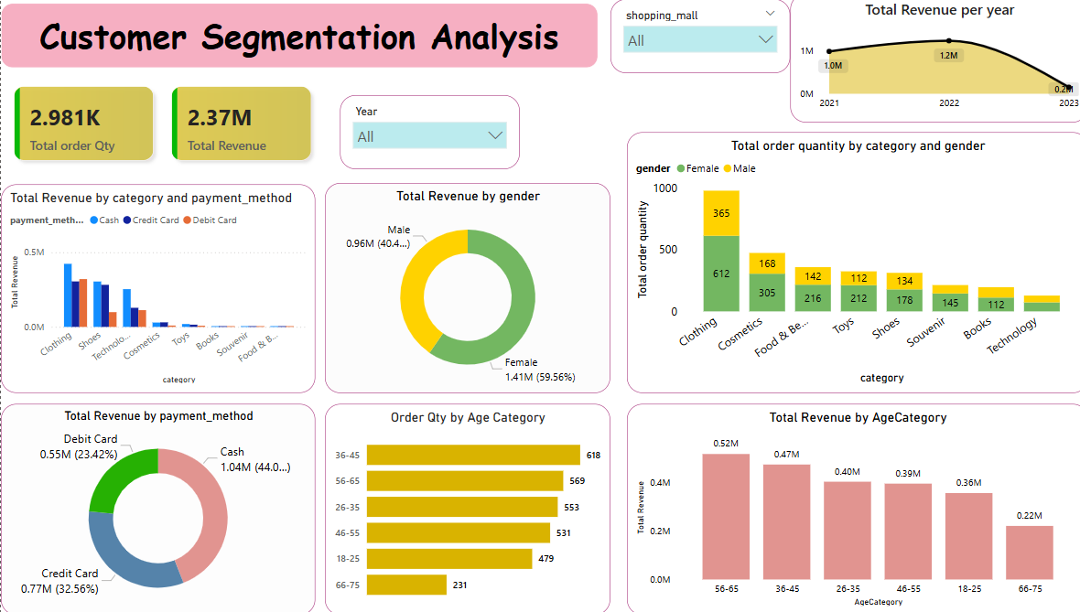

Slide 4
Insights
1. Female customers contributed 59.6% and Male customers contributed 40.4% of total revenue.
2. Female had the higher Order Quantity compared to Male .
3. Female customers generated more revenue with a contribution of 59.6%.
4. Clothing generated the Highest revenue for both the Genders & Shoes and Technology generated significant revenue with a slightly higher contribution from Females.
5. The 36-45 age group had the highest number of orders (618 orders), followed by 56-65 and 26-35 age groups.
6. Age group 36-45 and 56-65 have significant sales figures.
7. The 56-65 age group generated the highest revenue (0.52M), followed by the 36-45 age group (0.47M).
8. Clothing had the highest order quantity and is largely purchased by females.
9.Cash is most used payment method. The age group 56-65 has the highest revenue, possibly using cash more.
10.Cash was the highest used method , Debit & credit cards had a smaller share.

Slide 5
SUGGESTIONS
Target female customers more aggressively since they contribute the most revenue.
Focus marketing on the 36-65 age group, as they make the most purchases and generate the highest revenue.
Consider loyalty programs for high-value customers 56-65 age group.
Optimize payment methods: Since cash dominates, ensuring ease of access to card payments can improve sales.

Slide 6

Thank you!
ANY QUESTIONS?

